Slide 1
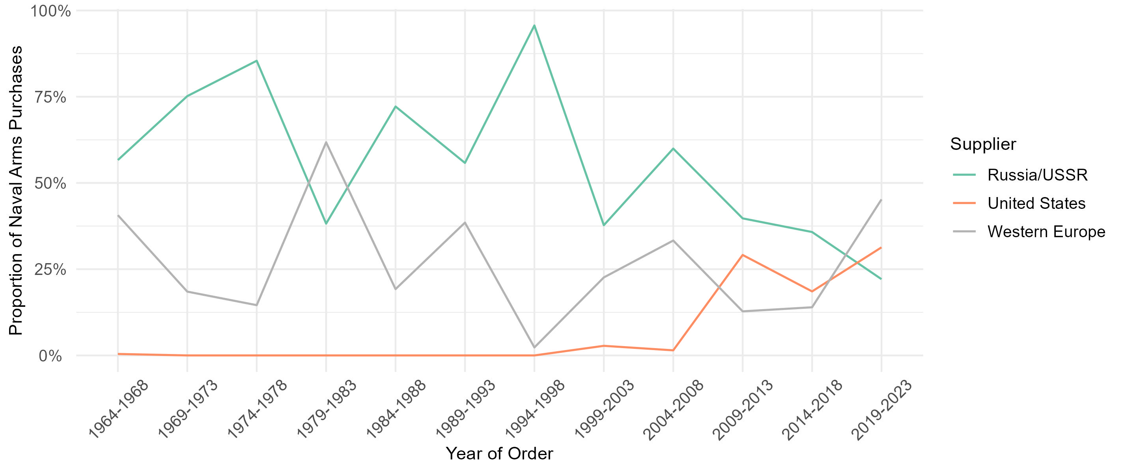
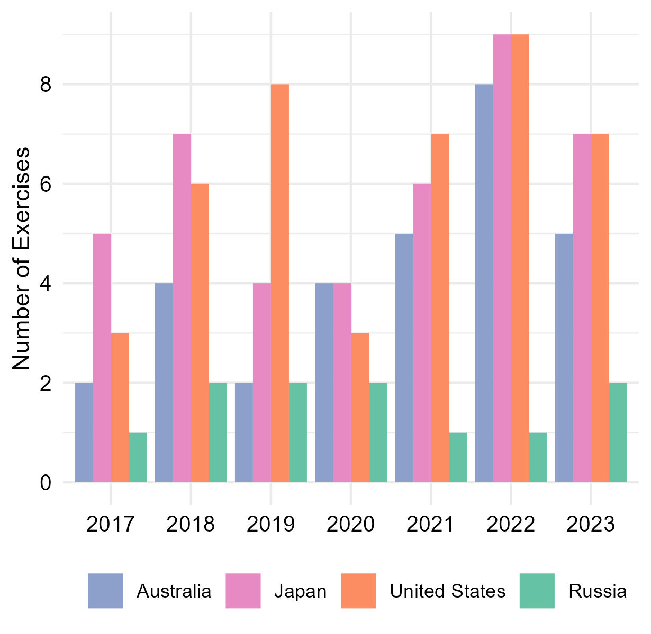

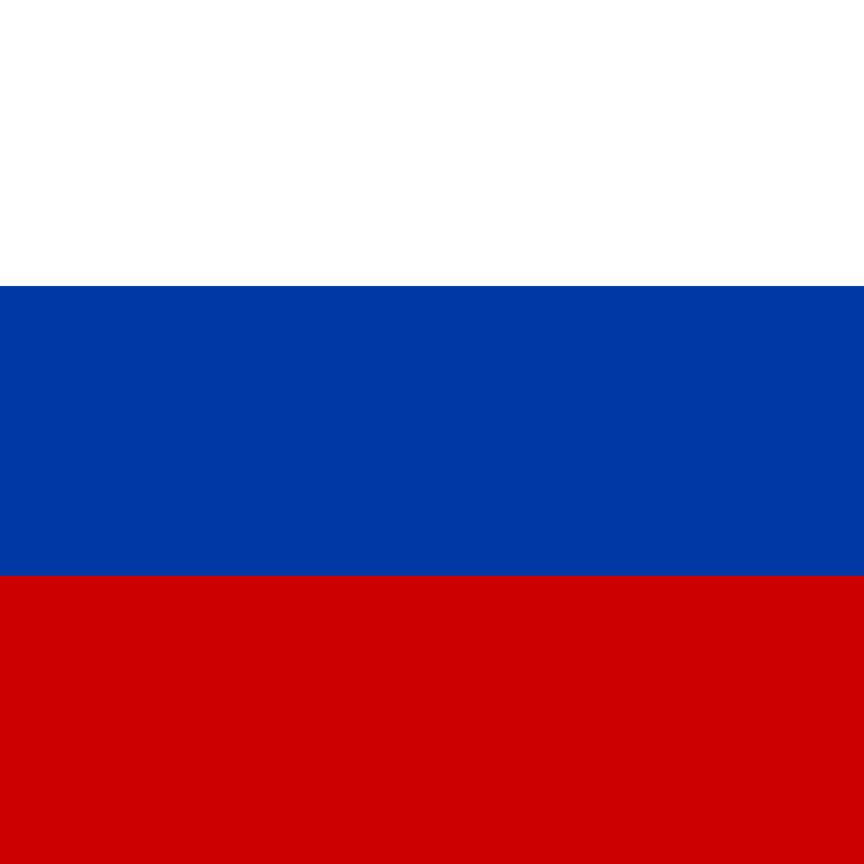
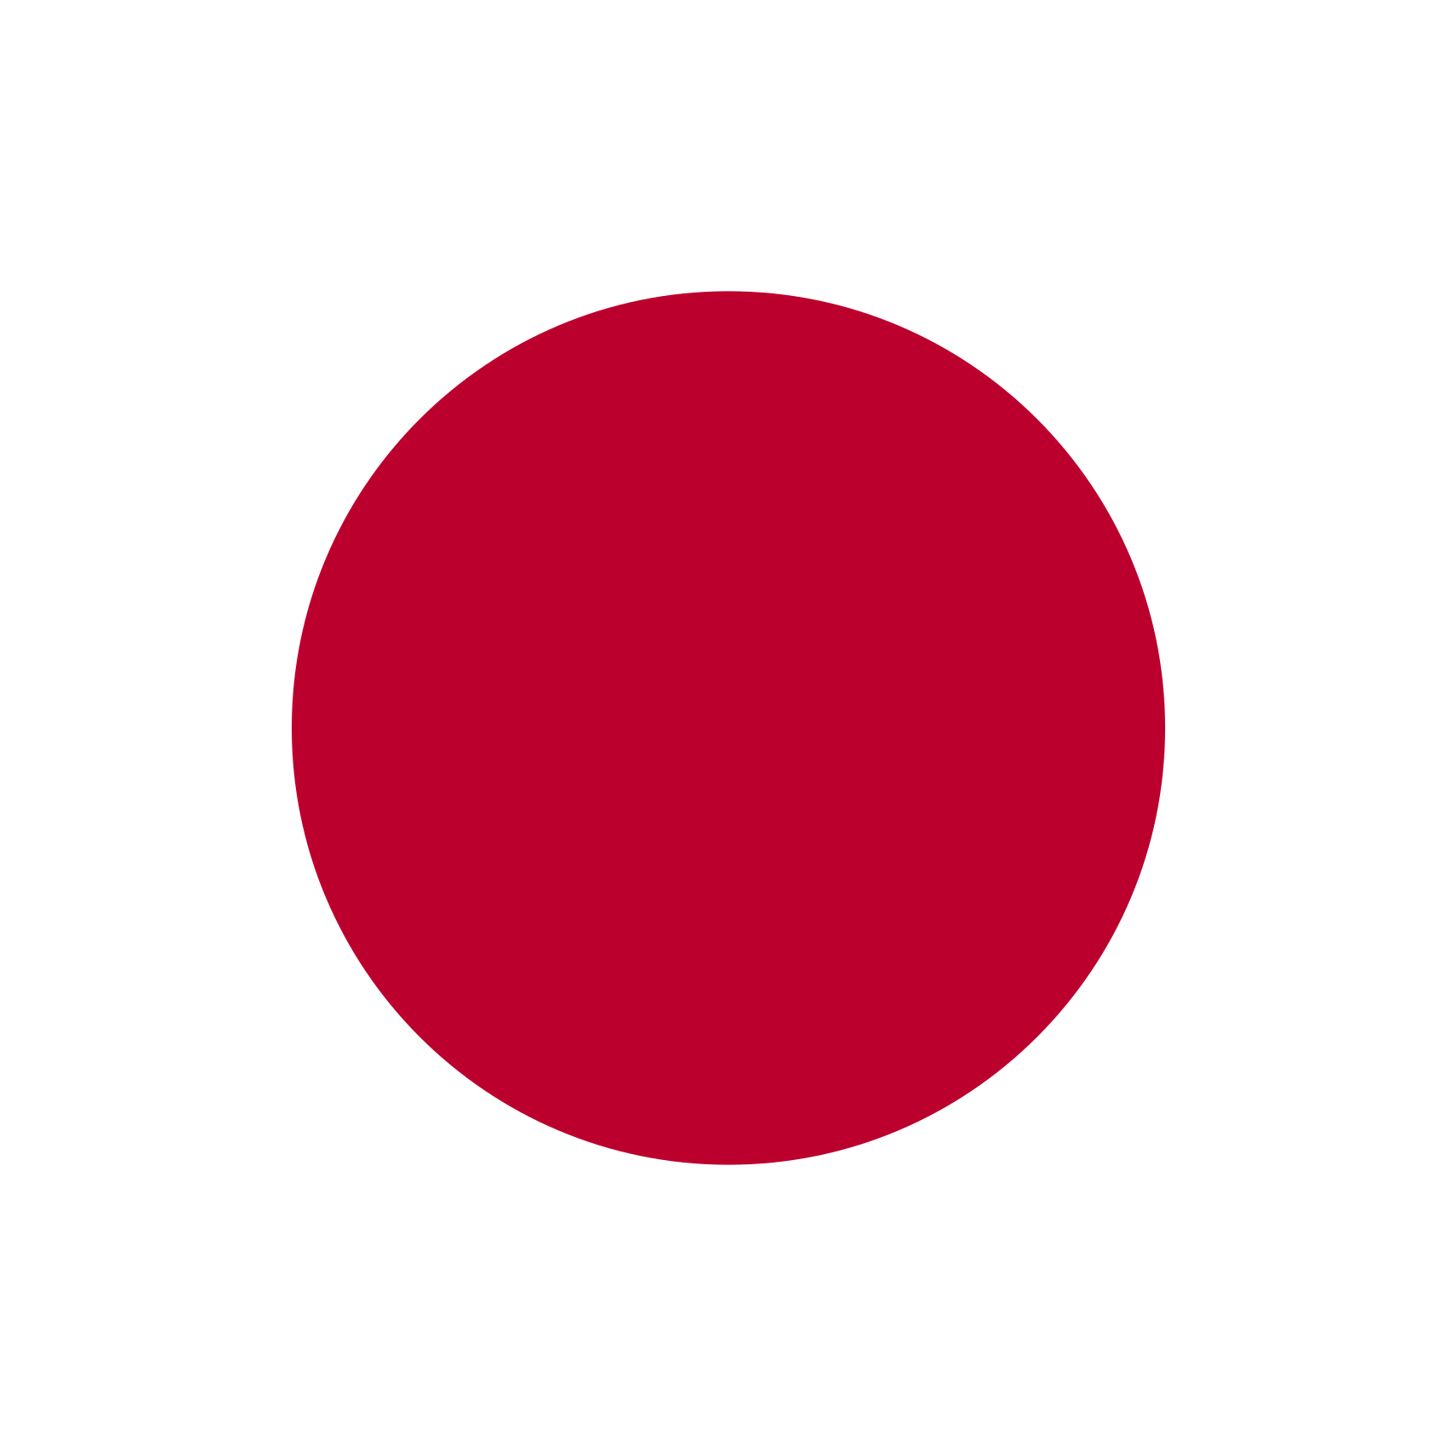

The Indian Navy’s Shifting Alignments
Data from India’s naval imports and joint exercises show that India’s maritime alignment with the Quad is increasing, while its maritime alignment with Russia is decreasing.
Diversification of Naval Arms Suppliers (1964-2023)
After decades of dependence on Russia, the Indian Navy is shifting toward Western European and U.S. suppliers.
Note: Western Europe includes Denmark, France, Germany, Italy, Netherlands, Germany, Spain, Sweden, and the UK
Source: SIPRI. Arms Transfers Database, 11 March 2024. https://armstransfers.sipri.org/ArmsTransfer/
Joint Naval Exercises with Quad Outpace Joint Naval Exercises with Russia
The number of Indian Navy exercises with Quad states increased from 2017-2023, while exercise INDRA with Russia has not been held since 2021.
Timeline of key exercises
1992
1st annual exercise Malabar with U.S.
2003
1st exercise INDRA with Russia
2012
1st exercise JIMEX with Japan
2014
Exercise INDRA held annually
2015
1st exercise AUSINDEX with Australia
2015
Japan added to exercise Malabar
2020
Australia added to exercise Malabar
2021
Exercise INDRA postponed
Source: Author’s count, based on official press releases, official social media accounts, and news articles

